Slide 1
Team 9 - The Jordans
Fernanda Rangel
Jan Castillo
Diego DuVall
Marco Solorzano

Slide 2
Justification
Basketball is one of the most popular sports in the world, especially in North America.
This sport is rich in all kind of statistics, it permits to have a very good analysis. With as much information as there is available, it is challenging to judge players of various positions by the same factor.
We set out to create a variable that would determine whether or not a player, on average throughout an entire season, had a positive or negative effect on his team and how that variable impacted and was impacted by other variables.

Slide 3

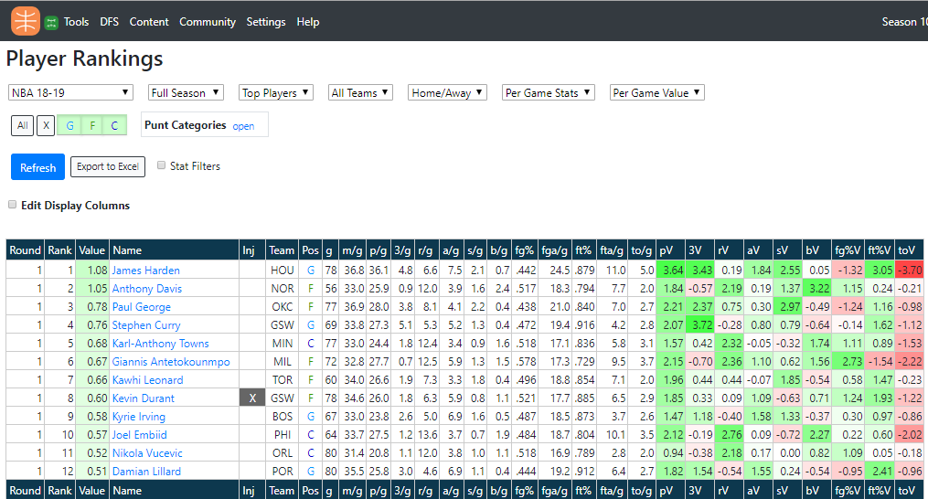
Our data sources
Basketball Monster
API - NBA

Slide 4
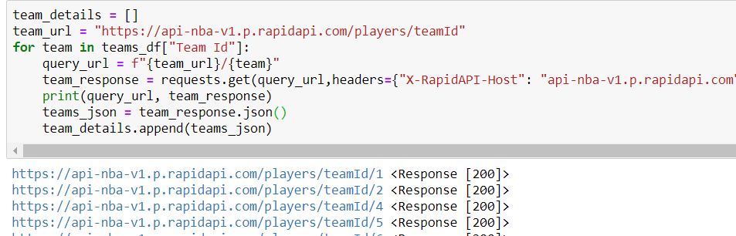
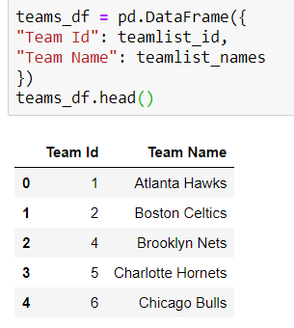
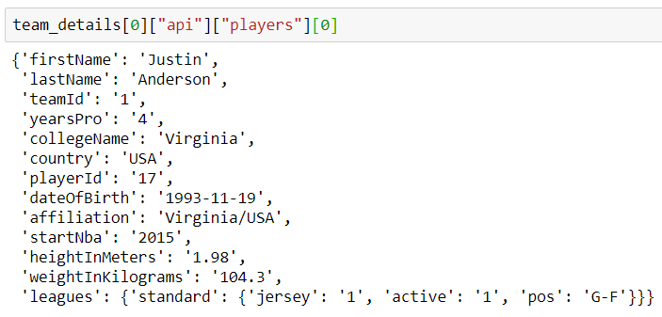
Exploration and Cleanup Process
Notes:
Jan

Slide 5
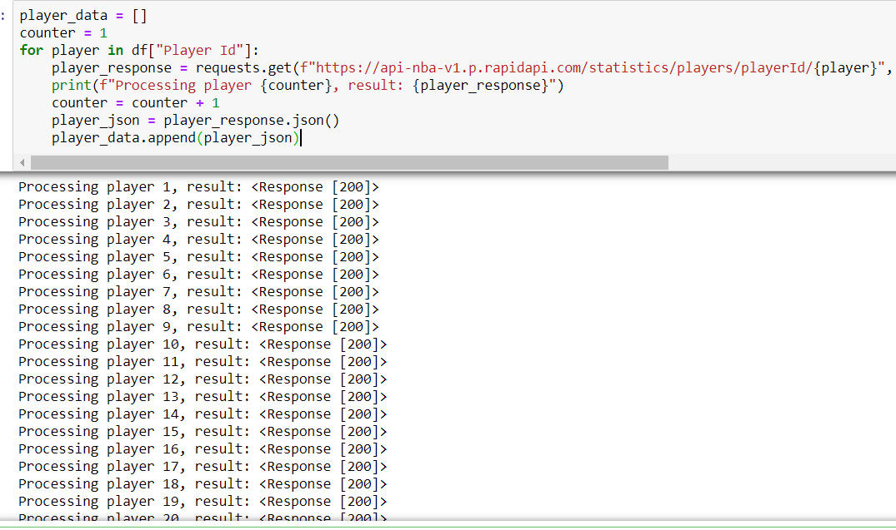
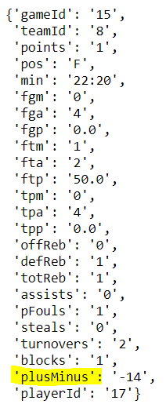
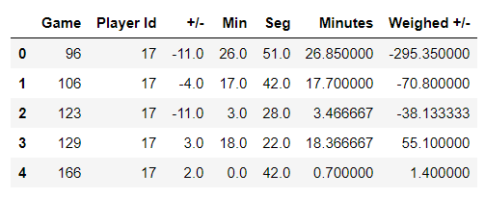
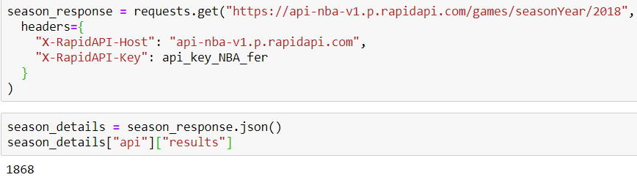
Notes:
Jan

Slide 6
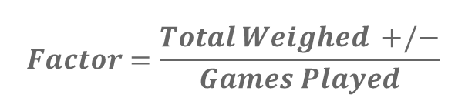
Our Variable
We took a players “+/-” (simply keeps track of the net changes in score when a given player is on the court) for each game he played in our sample size and multiplied it by the amount of minutes he played. This is our Weighed Plus Minus.
Afterwards – we simple divided the weighed plus minus by the amount of games the player had played in the 2018-2019 season in order to create our factor. Our factor is a single variable that indicates a players net effect on his team throughout the season.
$$Factor=\frac{Total Weighed +/−}{Games Played}$$

Slide 7
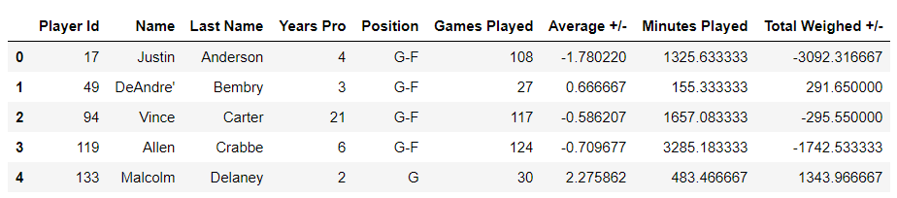
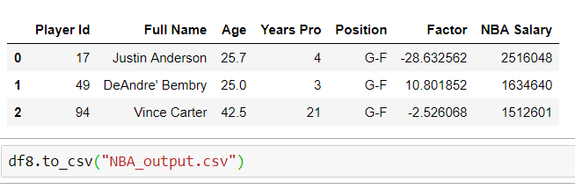

Slide 8
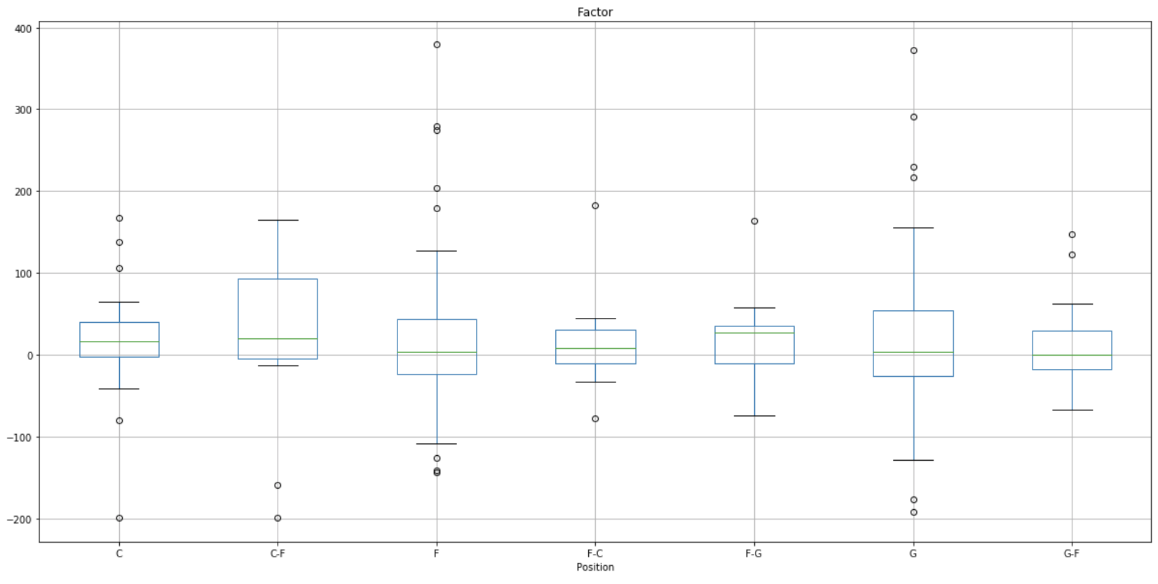
First Analysis
We did an anova analysis to check if the factor was statistically significant between positions.
With a p value of .97, We found that the mean of the factor was not statistically significant between positions, so we decided to see if there was another variable that could help us explain the importance of the factor that we had just created.
Graph 1. Boxplot gruped by position

Slide 9
What did we try to prove? Our variable is relevant based on logical assumptions
1.- What has a greater effect on someone’s factor? Their age? Or the amount of time that they have been in the league? If our variable that we created is relevant, it should be impacted significantly by one or both of these variables, age + years pro
2.- It is logical that the more a player makes in salary, chances are it’s because he performs better as a player than someone that is paid less. In order to prove the relevance of our factor, we decided to see how our factor impacted NBA players salary and see what insights we could draw.

Slide 10
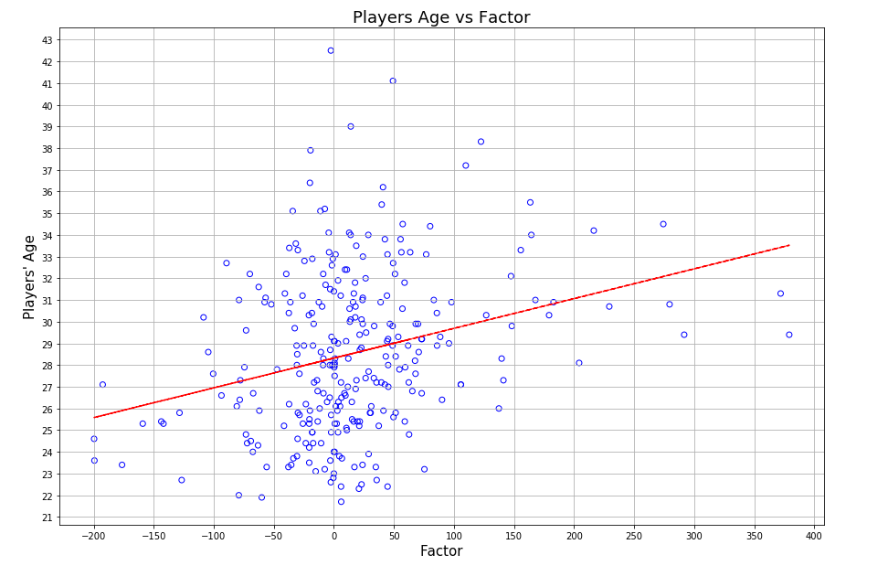
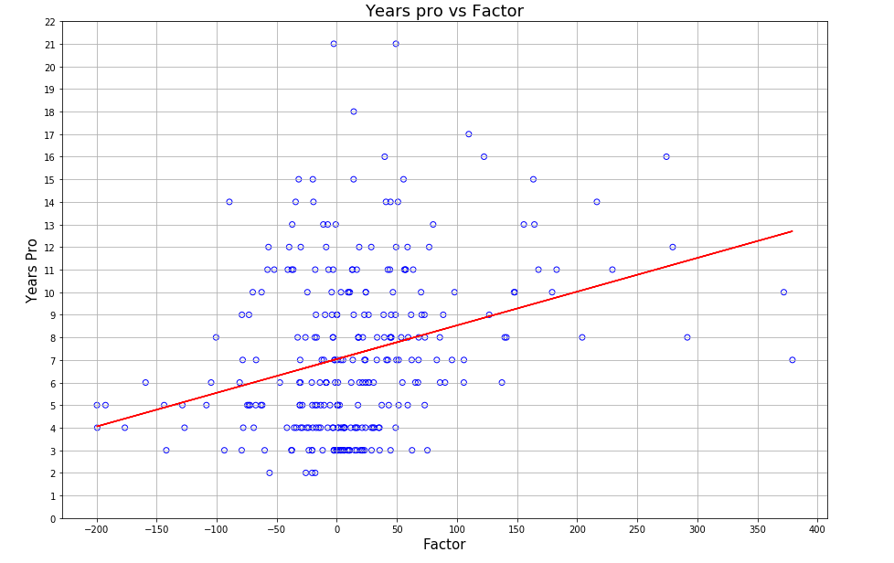
Age and Years Pro vs factor
Graph 2.1 – Age vs Factor
Graph 2.2 – Years Pro vs Factor
Positive relation between both graphs. But which variable impacts performance more?
Notes:
Diego

Slide 11
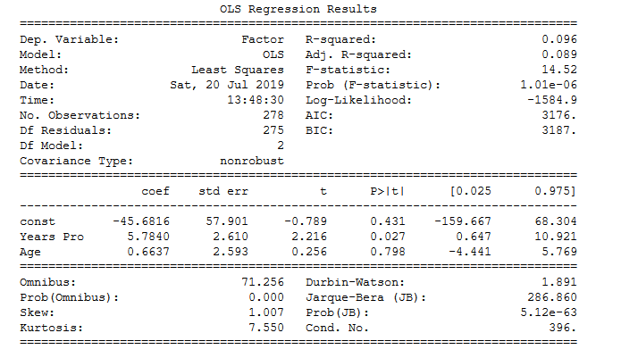
Regression Analysis – What impacts the factor more? Age or Years Pro ?
Notes:
Diego

Slide 12
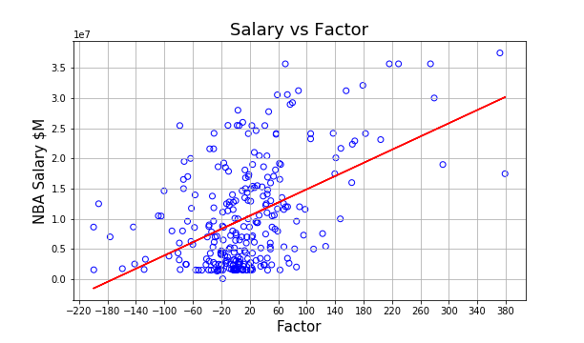
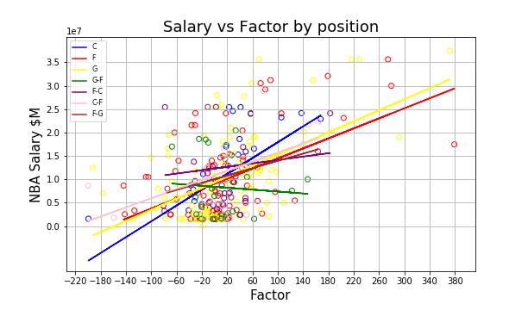
Salary vs factor
Graph 4.1
Graph 4.2
Also positive relation, but this time we can appreciate a stronger relation (grater slope) between our factor and how much do players earn per year.
Also we can apreciate a difference of Money Made vs Factor with players that play a single position vs players that play multiple positions.
Notes:
Diego

Slide 13
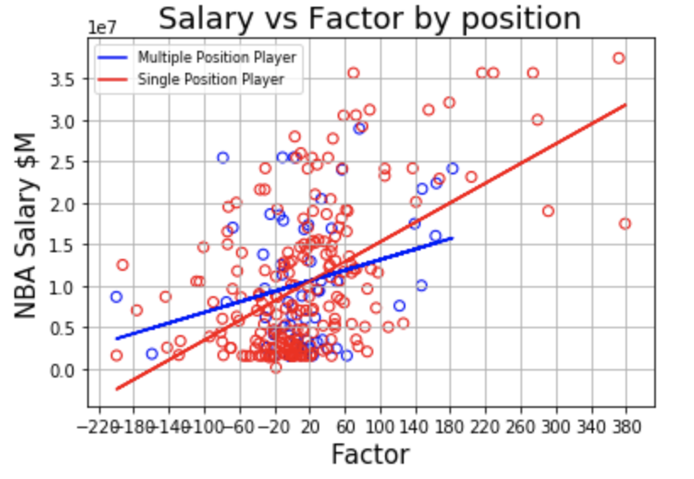
Salary vs factor (single vs mult positions)
Graph 5.
We decided to group the players that play single positions and multiple positions and to see if the factor impacted their salary more if they were a player that played multiple positions or single positions. In other words, are single position players paid higher for their productivity vs. players that play multiple positions
Notes:
Diego

Slide 14
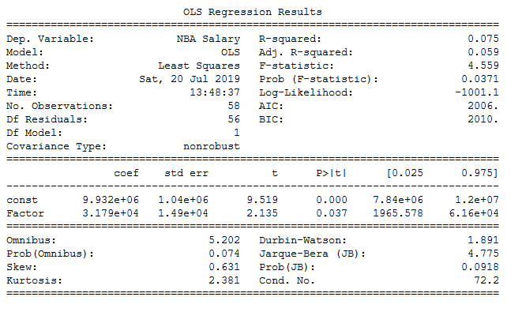
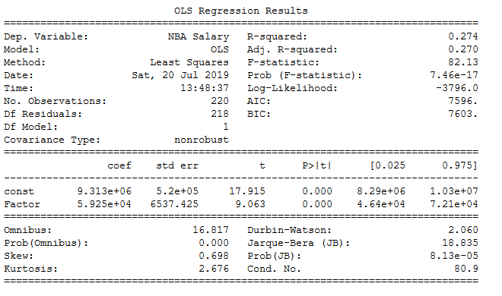
Salary vs factor
Salary vs. Factor (multiple position players)
Salary vs. Factor (single position players)
NBA salary has a higher t score (9.063 in single) vs. (2.135 in multiple), a lower p-value (.000 in single) vs. (.037 in multiple), and a higher R-Squared (.274 in single) v.s. (.075 in multiple) when comparing the readouts.
Notes:
Diego

Slide 15
Implications of your findings: what do your findings mean?
The amount of years that you have been playing in the league is a greater determinant than how old you are. This is understandable because if a player has remained in the league for a longer amount of time, it’s because he most likely has a positive impact on the team that he plays.
There is a strong relationship between how high your factor is and how much money you make. The higher your factor, the better net effect you have on your team, and teams are willing to pay more money for that. However, if you are a player that is a specialist in a single position rather than a multiple positional player, the more likeley it is youll get paid more money with a higer factor.

